Slide 1

Integration Security

Slide 2
Integration Error Security
1. Connectivity Security
Source -> Connecting to SFTP
Target -> Connecting to SuccessFactors
2. Data Security
Data in the file uploaded in SFTP
SAP Cloud Integration Logs

Slide 3
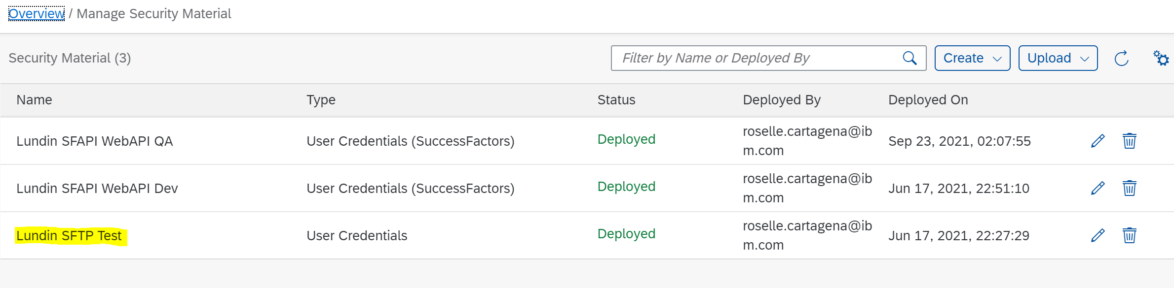
Integration Error Security
Connecting to SFTP
SFTP uses a single channel for digital communication whereas other protocols use multiple channels
The underlying SSH protocol includes layers of different types of security
These layers include data encryption, data integrity protective services, and server authentication
Authentication from CPI to SFTP occurs via alphanumeric username and password
This username and password is stored in the CPI Security Artifacts
Only administrators with access to CPI Security Artifacts can edit deployed username and password for SFTP

Slide 4
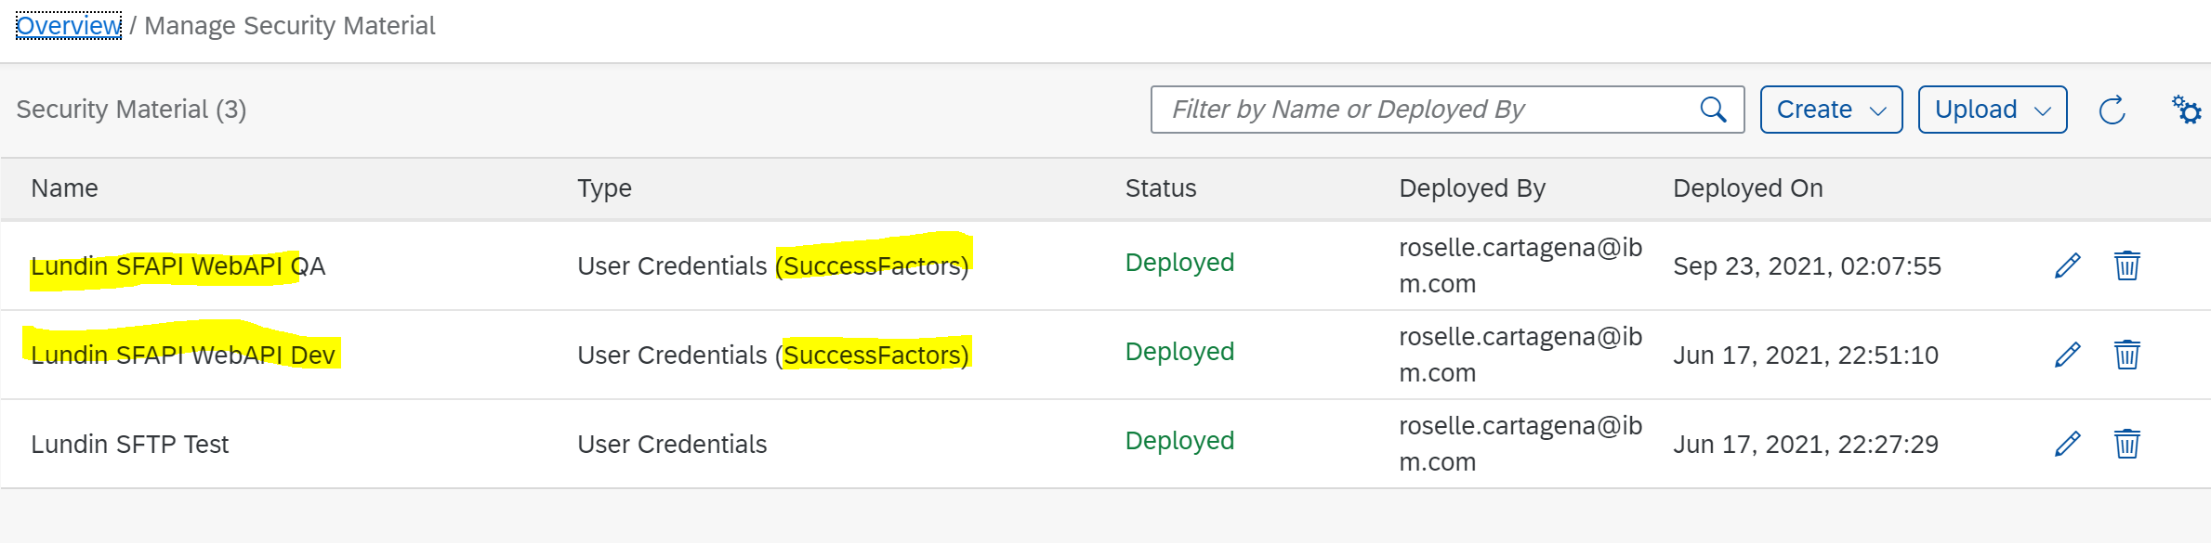
Integration Error Security
Connecting to SuccessFactors
By default, the SAP SuccessFactors solutions secure data through Transport Layer Security 1.2 256 bit encrypt for data-in-transit
Authentication from CPI to SF occurs via alphanumeric companyId, username and password
This companyId, username and password is stored in the CPI Security Artifacts
Only administrators with access to CPI Security Artifacts can edit deployed Security Artifacts for SuccessFactors

Slide 5
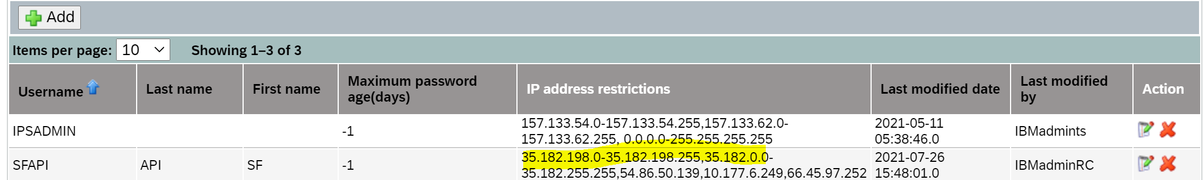
Integration Error Security
Connecting to SuccessFactors
The SFAPI User is given appropriate permissions before it can create and update data in SF
The IP Address range of system connecting to SF is whitelisted, outside this range, it won’t be able to connect to SF

Slide 6
Integration Error Security
Data uploaded in SFTP
Option1 -> No Encryption on the file
Leave the file as it is. Only people with access to SFTP can access files uploaded in SFTP.
Data is visible if the file is downloaded directly from SFTP.
Option2 -> Use PGP Encryption
Encrypt the file using PGP Encryption Key. Then CPI will decrypt the file during execution process only.
Data is not visible even if file is downloaded directly from SFTP.
Decryption key needs to be shared to CPI to be uploaded in the Security Artifacts and use during execution of file.

Slide 7
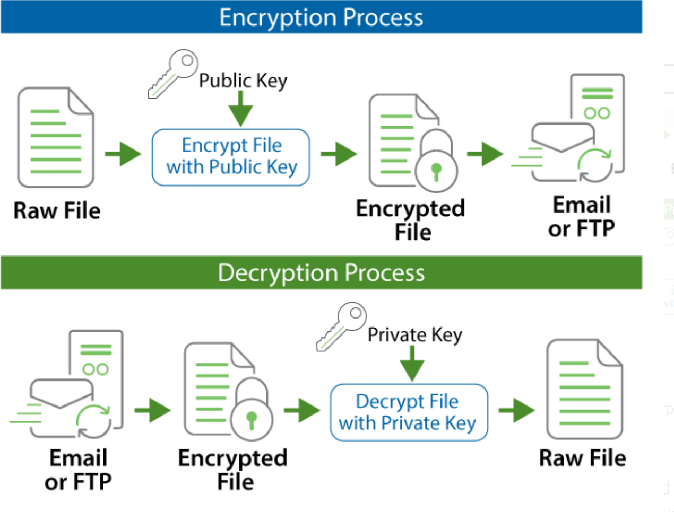
Integration Error Security
How PGP Encryption Works

Slide 8
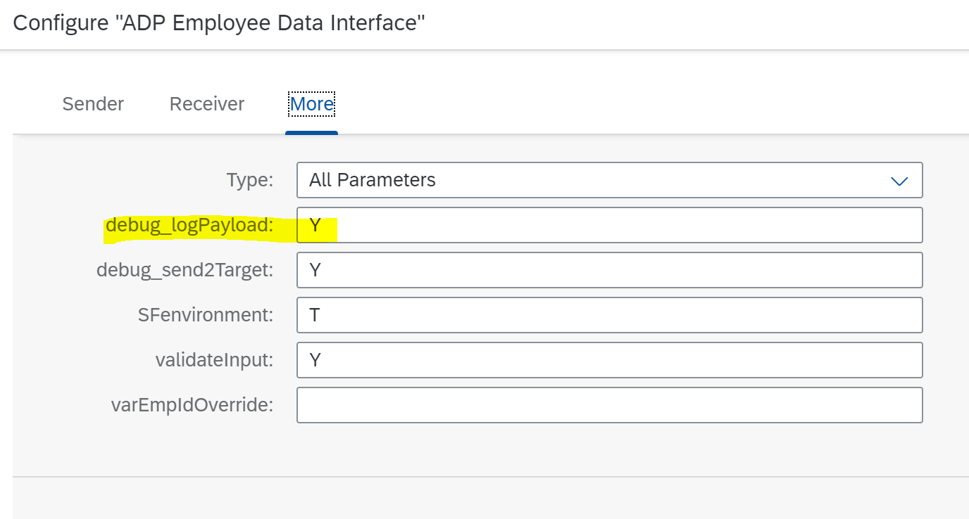
Integration Error Security
SAP Cloud Integration Logs
For each interface, a flag called debug_logPayload is created. It needs to be set to N (no) or Y (yes).
If this flag is set to Y (yes), then logs with sensitive data are encrypted and are visible in the Monitoring page of CPI.
Pros: Debugging is easy in case of errors/exceptions.

Slide 9
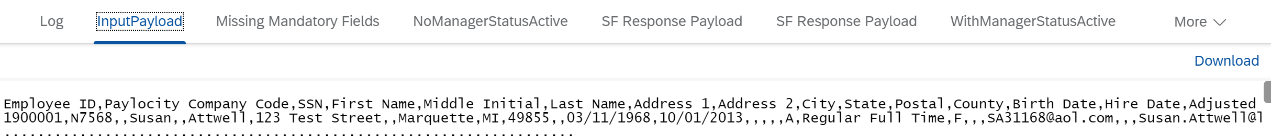
Integration Error Security
SAP Cloud Integration Logs

Slide 10
Integration Error Security
SAP Cloud Integration Logs
If this flag is set to N (no), then logs with sensitive data are encrypted but not visible in the Monitoring page of CPI.
Cons: Debugging is difficult in case of errors/exceptions.

